Slide 1

Keyboard Typing bot
Peer Learning Sessions (PLS)
Presented By :
MELBA ELSA JOE
Roll No 16
RIYA KUMARI
Roll No 28
KHUSHI CHAUDHARY
Roll No 38
ANOUSKHA SHARMA
Roll No 45
APRIL
2024
NIT SURAT
*

Slide 2

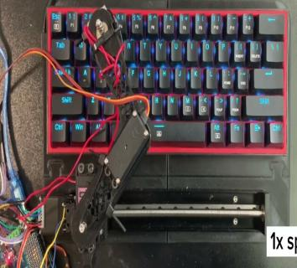
KEYBOARD
TYPING BOT
AI PROJECT 2024
NIT SURAT

Slide 3
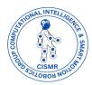
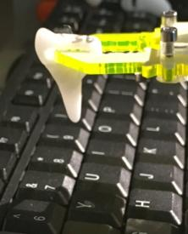
problem statement
This project focuses on constructing a voice-controlled typing robot. The robot receives human speech as inputs via a microphone, which are then processed through an Arduino microcontroller. The output is produced by a robotic arm, guided by a servo motor.
NIT SURAT

Slide 4
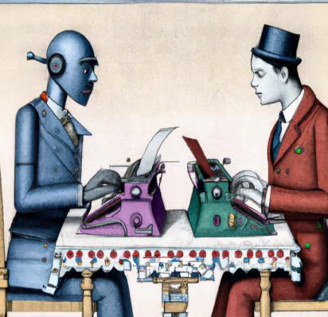
OBJECTIVE
The purpose of this robot is to minimize human errors while typing. As it is voice-controlled, it can be can serve as aid for people with physical disabilities.
NIT SURAT

Slide 5

Assumption
We are considering the assumption that the keyboard is
fixed and all keyboards have same structure and same gaps between letters

Slide 6

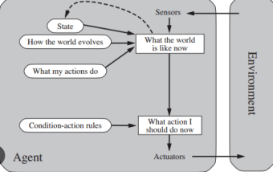
Agent
We are using goal based agent for NLP and using reflex based agent for our robotic arm

Slide 7
PEAS
PERFORMANCE MEASURE
Accuracy with which typing is achieved by the robot
ENVIRONMENT
Keyboard,computer screen
ACTUATOR
servo motor,Ice Cream stick
SENSOR
Microphone

Slide 8

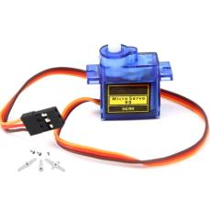
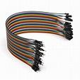
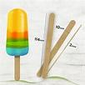
Hardware required
-Arudino Board
-Icecream stick
-Male to male jumper wires
- Servo Motor
NIT SURAT

Slide 9
Implementation
Integration of NLP based voice-to-text conversion with Arduino driven typing functionality.
Python libraries enable robust voice recognition and Real-time transmission of text data to Arduino via serial communication.
Enhances accessibility with hands-free text input through voice commands.
Represents a fusion of NLP and Arduino technology for efficient human-computer interaction.
NIT SURAT

Slide 10
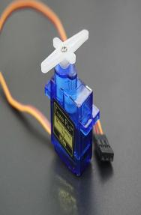
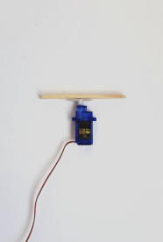
Operation
Linear Motion Control:
The bottom servo motor will ehibit planar along the desired path to traverse around the keys on the keyboard.
Horizontal Motion Control:
The middle servo motor will adjust its position to reach specific rows on the keyboard.
Key Pressing Action:
The top servo motor will be responsible for accurately pressing the keys on the keyboard.
NIT SURAT

Slide 11
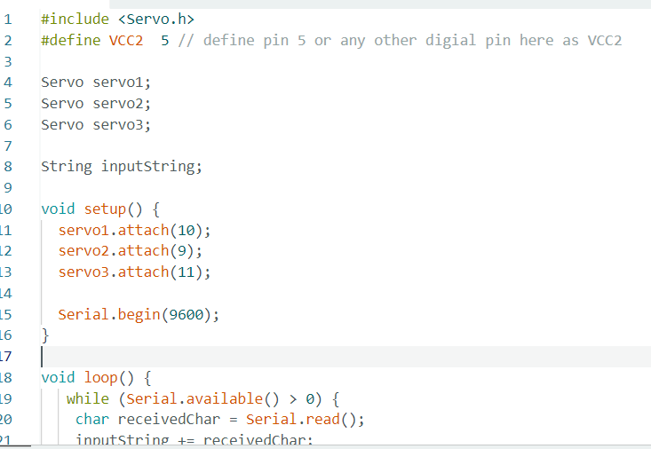
DATA INPUT OUTPUT FORMAT
Input
Input is given in the form of voice through NLP
Output
Output is delivered by a robotic arm guided by servo motors
NIT SURAT

Slide 12

Methodology
1. Programming Logic
- Determine the correct positioning of the robotic
arm for typing letters.
- Specify rotation angles for precise arm movement.
2. Keyboard Mapping
- Each letter corresponds to a specific angle.
- Map angles to keyboard keys.
3. Typing Process
- Achieve the exact angle for a specific letter.
- Robotic arm moves downward to press the key.
- Followed by an upward motion to return to initial position.
4. Letter Sequencing
- Introduce a delay between consecutive letters.
- Ensure correct key sequence without skipping alphabets.
NIT SURAT

Slide 13
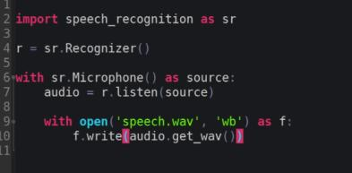
AI Modules
Speech Recognition (speech_recognition): This module allows our script to recognize speech from audio input. In our script, it's imported as sr. The Recognizer class from this module is used to perform speech recognition. Specifically:
r = sr.Recognizer(): Initializes a recognizer object, which is used to recognize speech.
with sr.Microphone() as source2:: Sets up the microphone as the audio source for speech recognition.
r.adjust_for_ambient_noise(source2, duration=0.2): Adjusts for ambient noise to improve recognition accuracy.
audio2 = r.listen(source2): Records audio from the microphone.
MyText = r.recognize_google(audio2): Uses Google's speech recognition service to transcribe the recorded audio into text.
Text-to-Speech (pyttsx3): pyttsx3 is used for converting text into speech. This module is used for providing audible feedback to the user. In our script:
SpeakText(MyText): Initiates the text-to-speech conversion of the recognized text (MyText) and plays it back using the system's audio output.

Slide 14
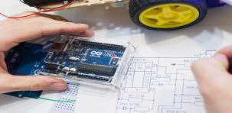
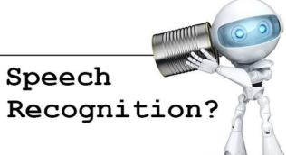

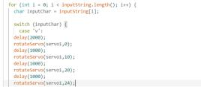
Learning
Speech Recognition Integration: Learning to integrate speech recognition functionality into a Python script. This involves understanding how to capture audio input from a microphone,.
Serial Communication with Arduino: Learning to establish serial communication between a Python script and an Arduino board. This involves configuring the serial port settings, sending data from Python to the Arduino, and receiving data from the Arduino in Python.
Arduino Programming for Motor Control: Understanding how to program an Arduino board to control servo motors. This includes initializing servo motor objects, setting servo positions based on received commands, and handling servo movements smoothly.
Error Handling: Learning to implement error handling mechanisms to gracefully handle exceptions and errors that may occur during runtime. This includes catching and handling specific types of errors, such as RequestError and UnknownValueError, in the speech recognition process.
Integration of Hardware and Software: Gaining experience in integrating hardware components (microphone, Arduino board, servo motors) with software components (Python script) to create a functioning system. This involves ensuring compatibility between hardware and software interfaces and troubleshooting any issues that arise during integration.
Iterative Development and Testing: Learning to iteratively develop and test the project by incrementally adding features, debugging code, and refining functionality based on testing results and user feedback. This involves a systematic approach to development, including writing code, testing it thoroughly, and making necessary adjustments.

Slide 15
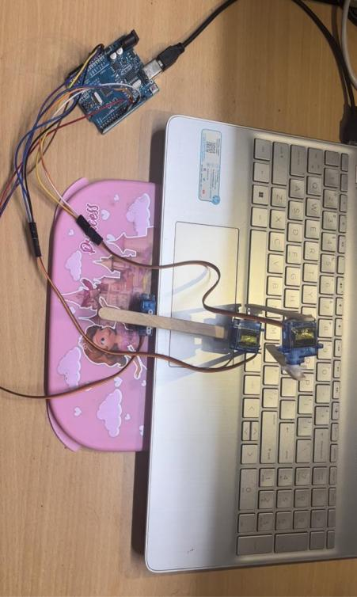
FINAL LOOK OF PROJECT
NIT SURAT

Slide 16
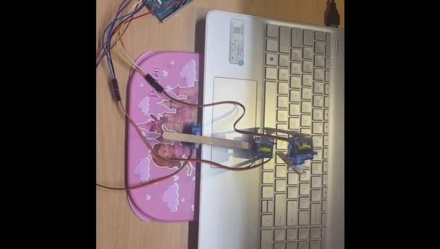
Working video

